Slide 1
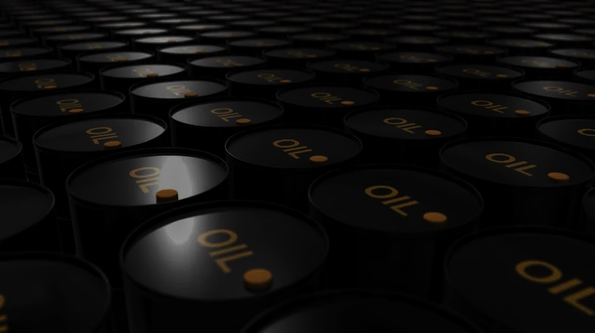
PROJECT
PROJECT
OIL PRICE PREDICTION
Guided By – Karthik Sir.

Slide 2
PROBLEM STATEMENT
PROJECT
OIL IS A PRODUCT THAT GOES COMPLETELY IN A DIFFERENT DIRECTION FOR A SINGLE MARKET EVENT AS THE OIL PRICES ARE RARELY BASED ON REAL-TIME DATA, INSTEAD, IT IS DRIVEN BY EXTERNALITIES MAKING OUR ATTEMPT TO FORECAST IT EVEN MORE CHALLENGING

Slide 3
PROJECT
Project Flow-
Data Extraction.
EDA
Data Pre-Processing

Slide 4
DATA DESCRIPTION
PROJECT
The data file contains 2 features
DATE
PRICE
Based on the data we have to build the best model which gives the maximum performance

Slide 5
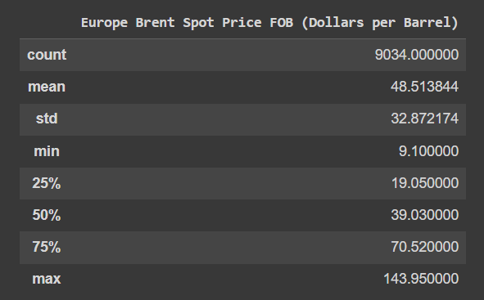
df.describe()
PROJECT

Slide 6
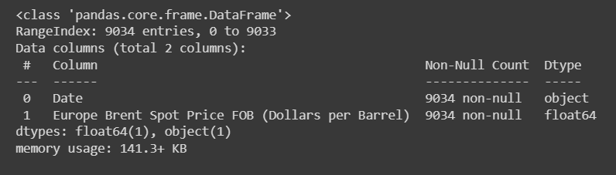
df.info()
PROJECT

Slide 7
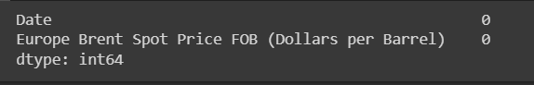
df.isnull().sum()
PROJECT
df.duplicated().sum()
Well, the function returned '0'.This means, there is not a single dupli-cate value present in our dataset and it is very good thing to know.

Slide 8
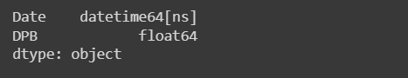
In Feature engineering we rename the columns and change the date format and also change date time column object to date time
PROJECT
df.rename()

Slide 9
PROJECT
Visualization

Slide 10
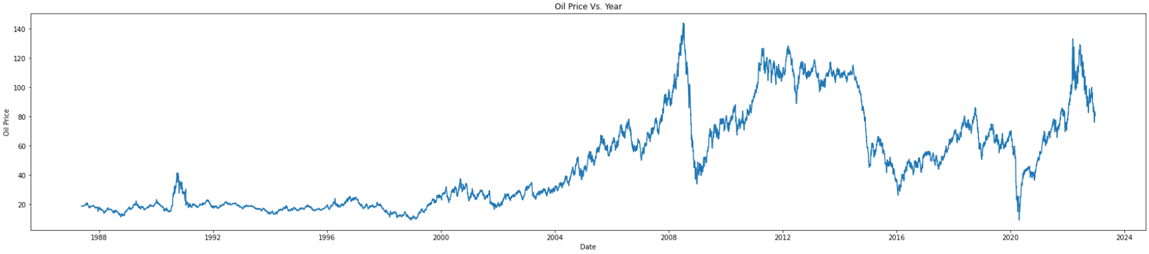
Line Plot
PROJECT

Slide 11
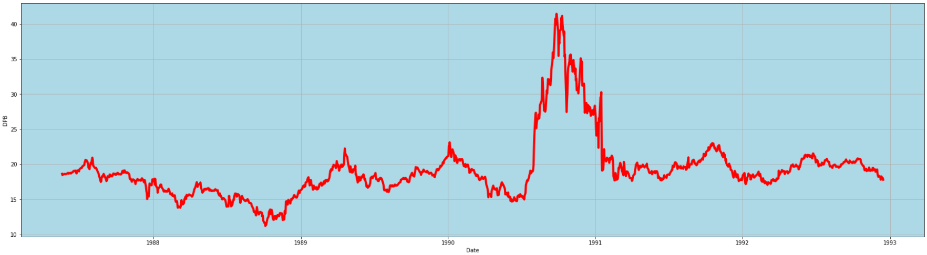
Line Plot (1987-1993)
(Line through different phrases)
PROJECT

Slide 12
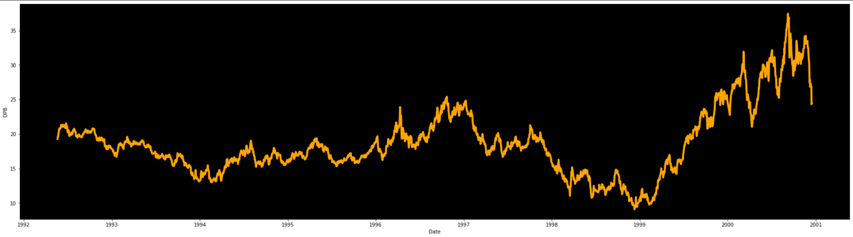
Line Plot (1993-2000)
(Line through different phrases)
PROJECT

Slide 13
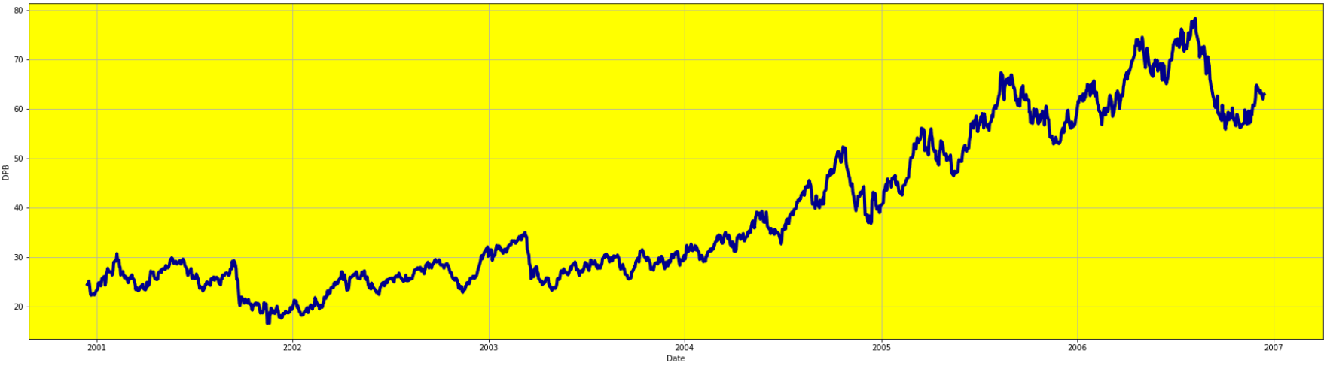
Line Plot (2000-2006)
(Line through different phrases)
PROJECT

Slide 14
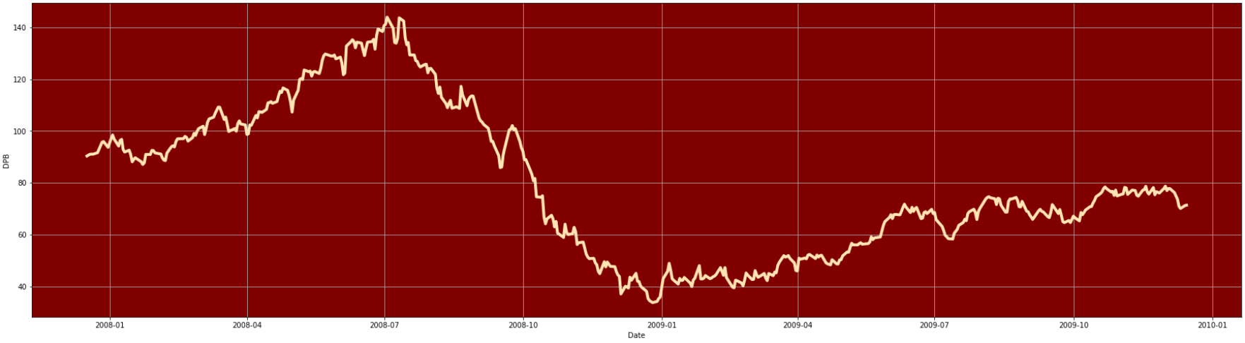
Line Plot (2007-2009) Recession phase
(Line through different phrases)
PROJECT

Slide 15
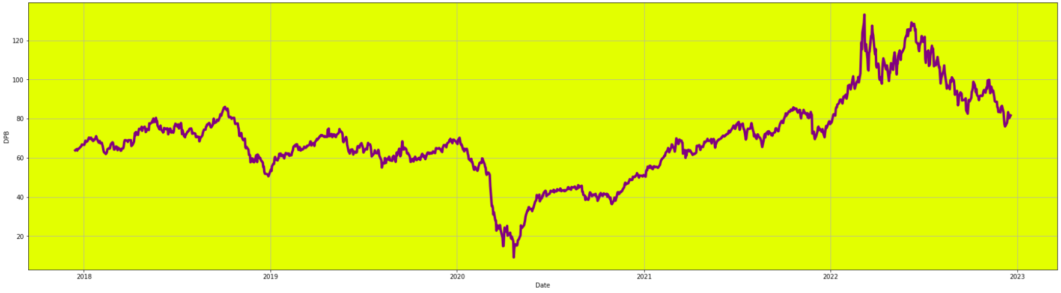
Line Plot (2017-2022) Pandemic phase
(Line through different phrases)
PROJECT

Slide 16
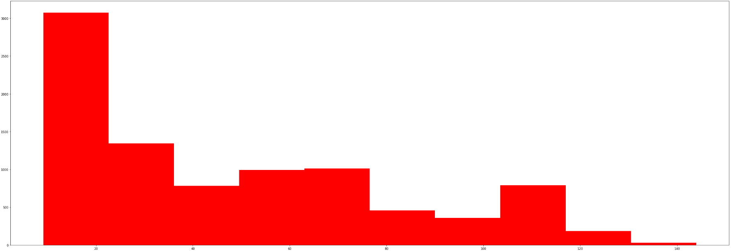
Histogram
PROJECT

Slide 17
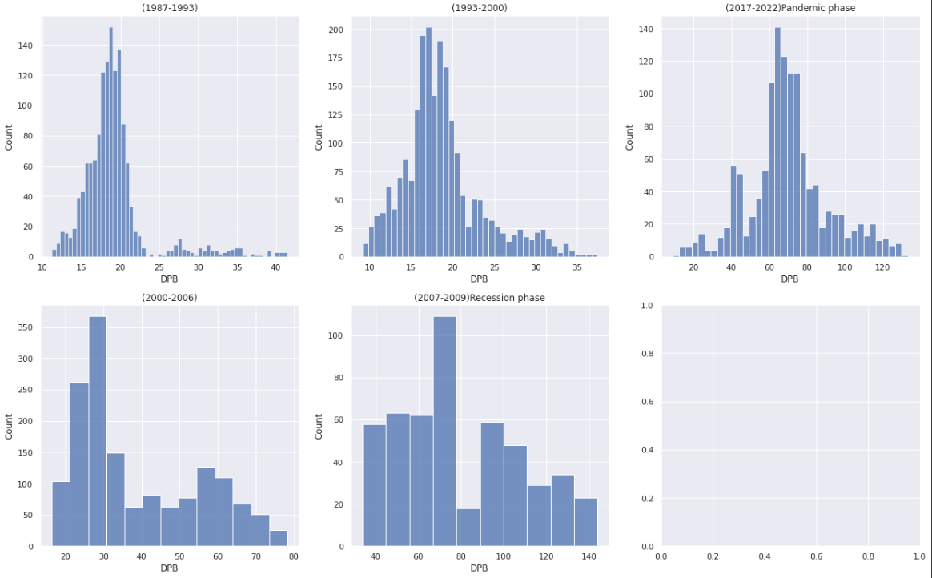
Histogram according to different phrases
PROJECT
(From above visual Trend we can see that the data is right skewed and the data has different trend at different level)

Slide 18
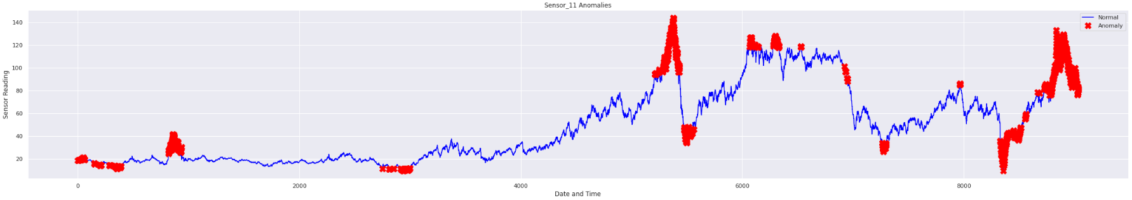
Isolation forest
PROJECT
(This data have irregular trend with combination of linear and constant trend over the time.)

Slide 19
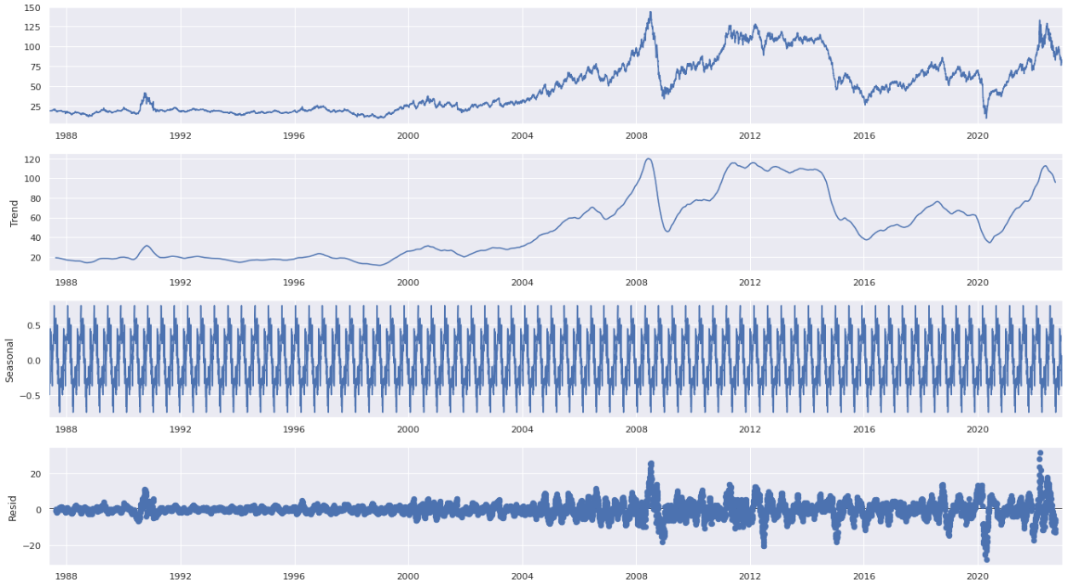
Time Series Decomposition
PROJECT

Slide 20
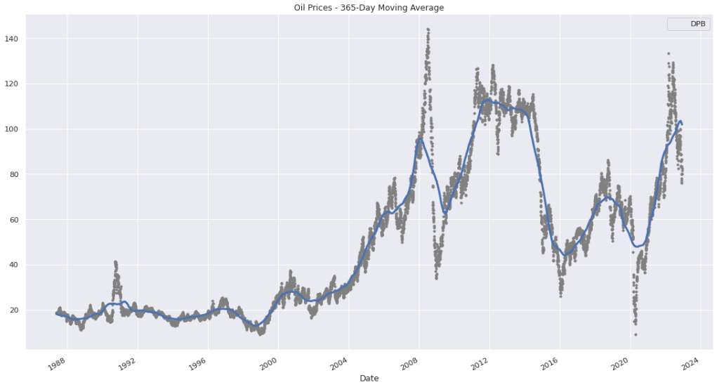
Trend
PROJECT
From the above plot, we can see that there is so constant direction of the mean which is understandable as there might be many external factors involved in price fluctuation.

Slide 21
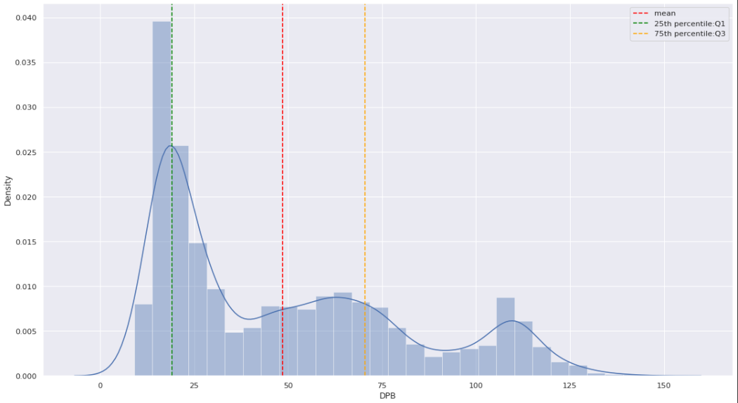
Displot
PROJECT
(We can see from above Displot data is not normally distributed)

Slide 22
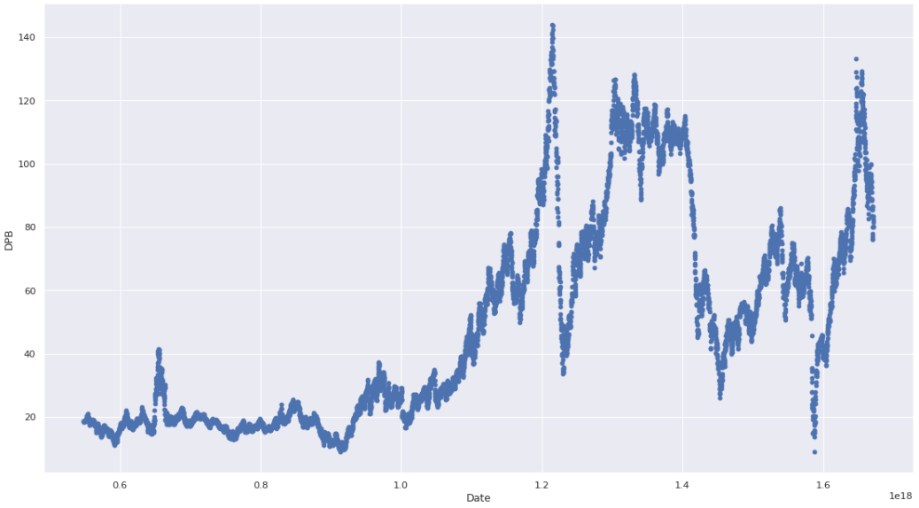
Scatter Plot
PROJECT

Slide 23
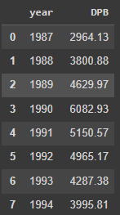
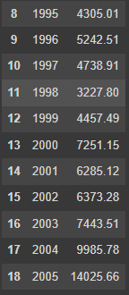
Let visualizing the sum of all sales each year. We can do that using group of Price and Date and group by Year
PROJECT

Slide 24
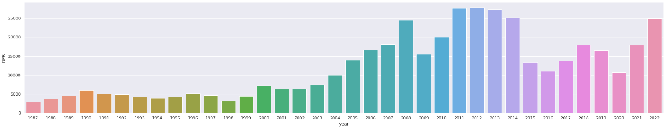
Cat Plot
PROJECT

Slide 25
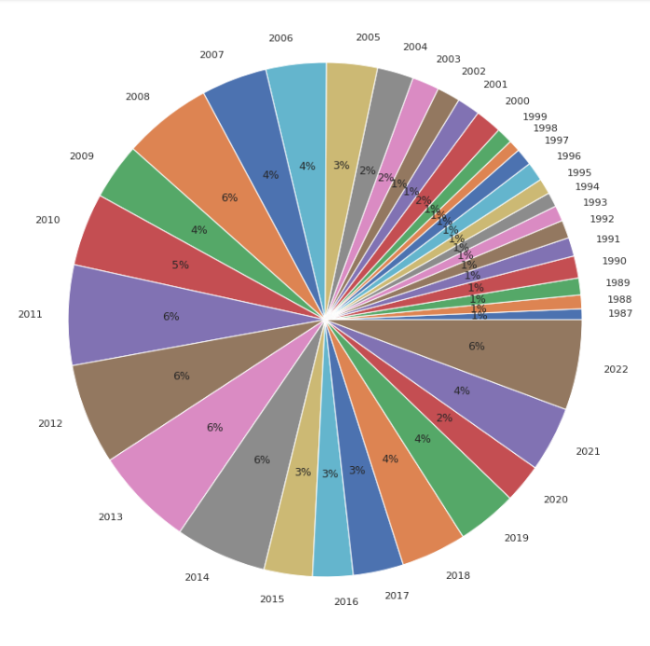
Pie Chart
PROJECT

Slide 26
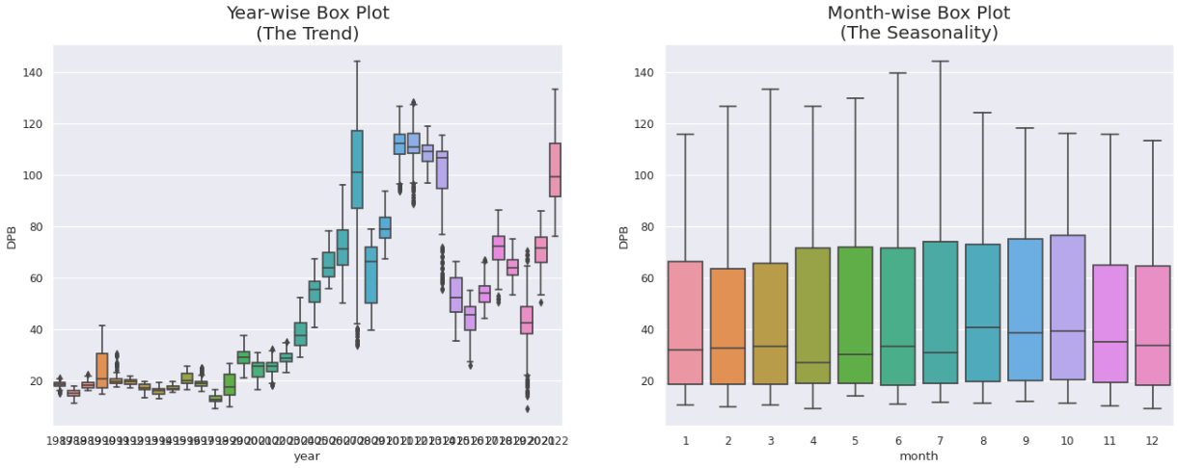
Monthly & Yearly Oil price
(Trend and Seasonability)
PROJECT

Slide 27
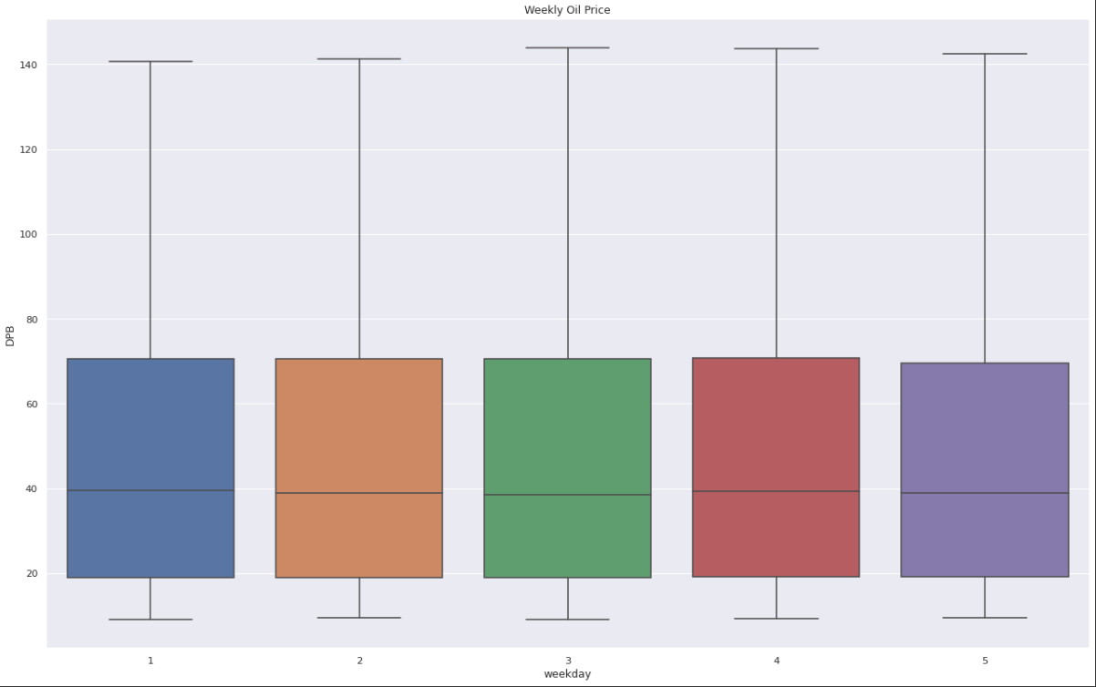
Weekly Box Plot
(Weekly box plot)
PROJECT

Slide 28
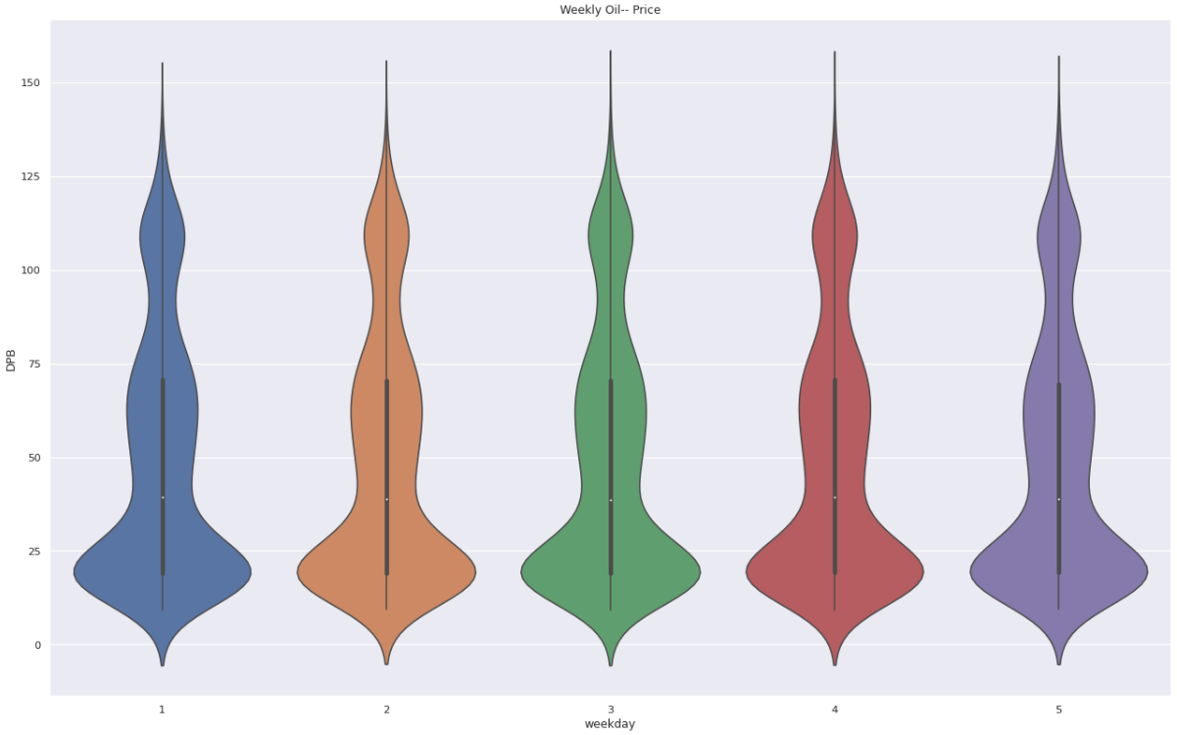
Weekly Volinplot
PROJECT

Slide 29
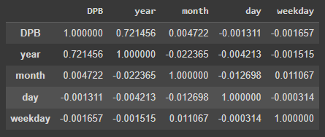
Correlation Plot - EDA
PROJECT

Slide 30
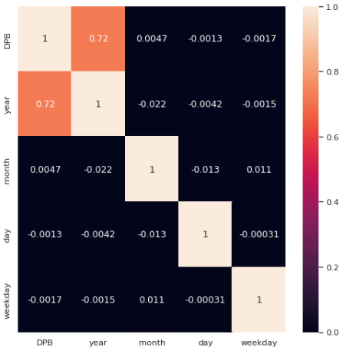
Correlation Plot
PROJECT

Slide 31
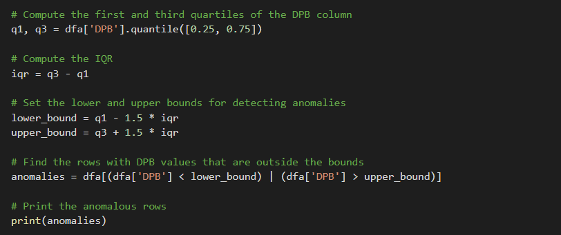
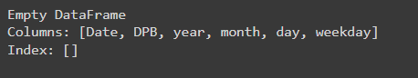
Anamoly detection and treatment
PROJECT
No anomalous values in data

Slide 32
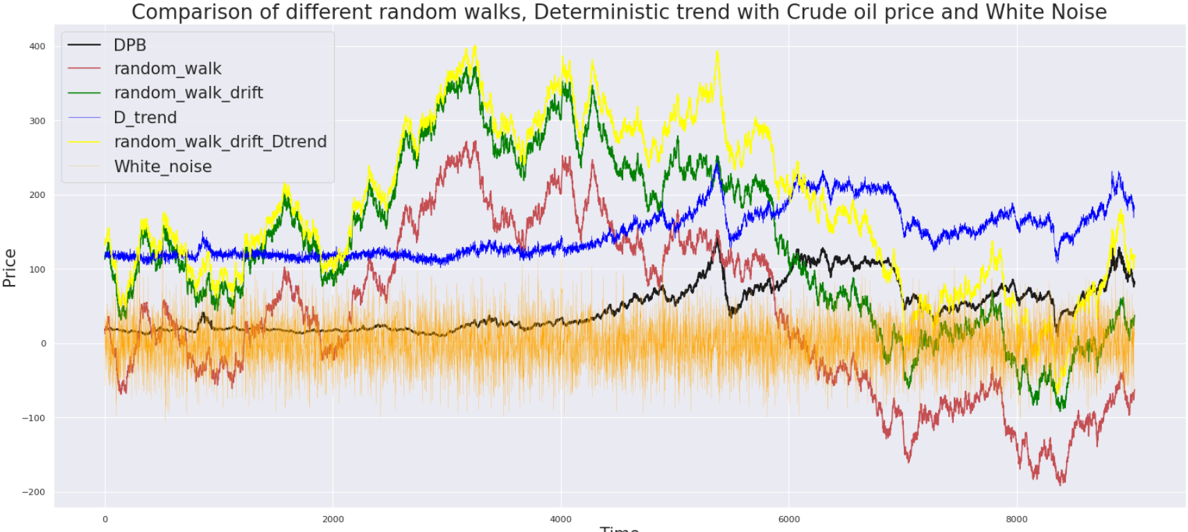
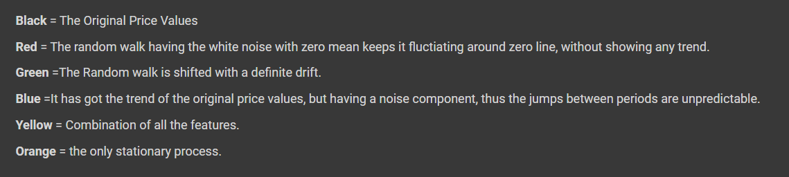
Time series decomposition
PROJECT

Slide 33
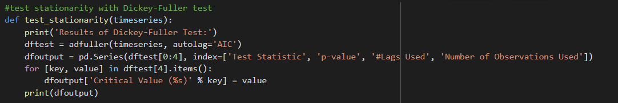
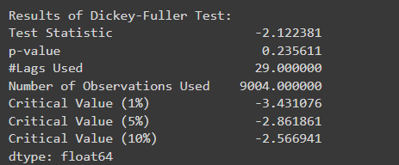
Checking if data is stationarity or not
PROJECT

Slide 34
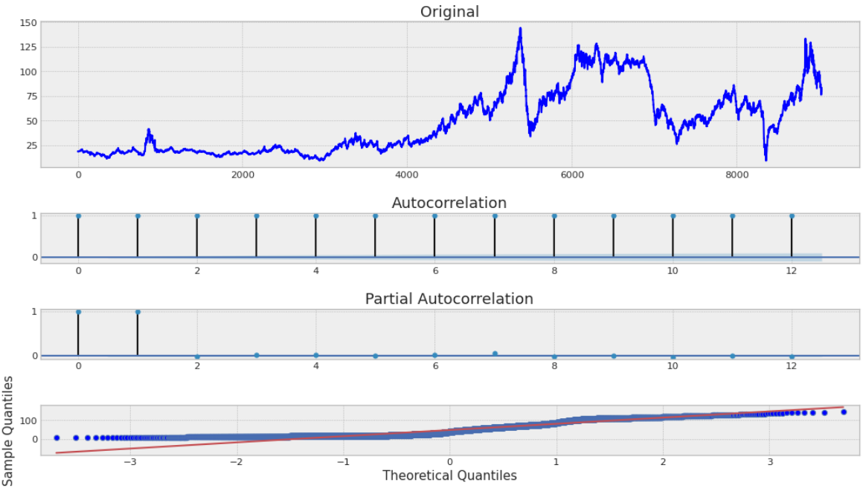

Slide 35
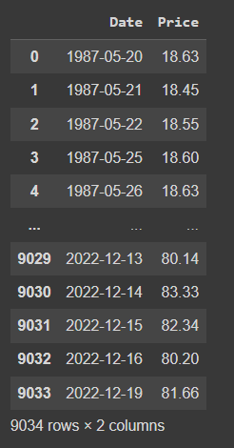
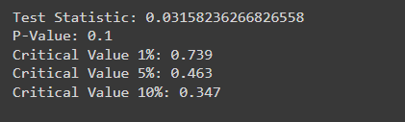
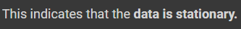
Making a time series stationary
Boxcox Transformation
PROJECT

Slide 36
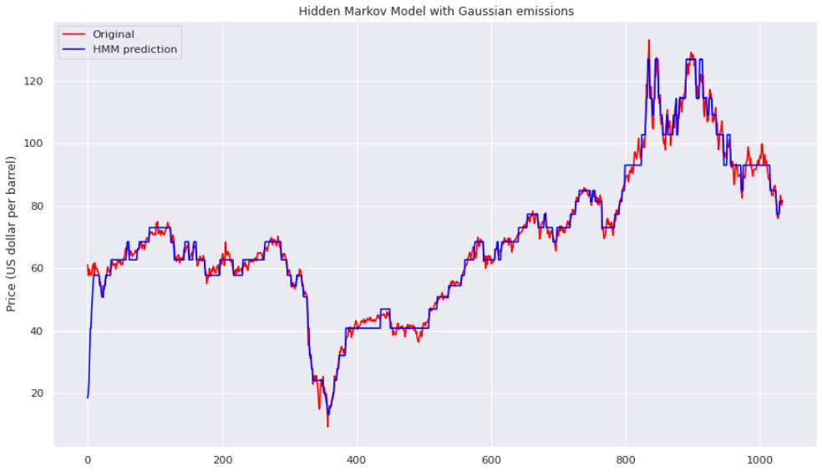
Models
1)HMM-Hidden Markov Model with Gaussian emissions
PROJECT

Slide 37
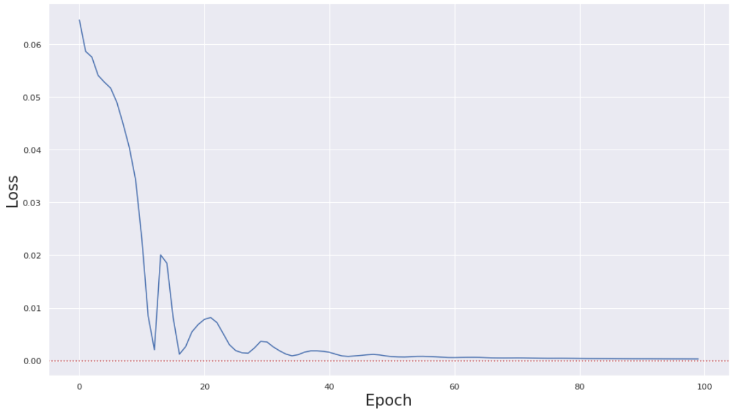
2) LSTM-Long short term memory
PROJECT

Slide 38
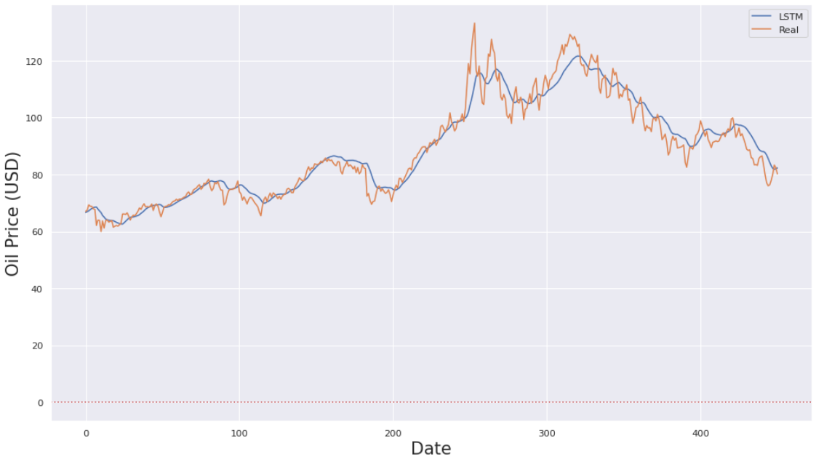
PROJECT

Slide 39
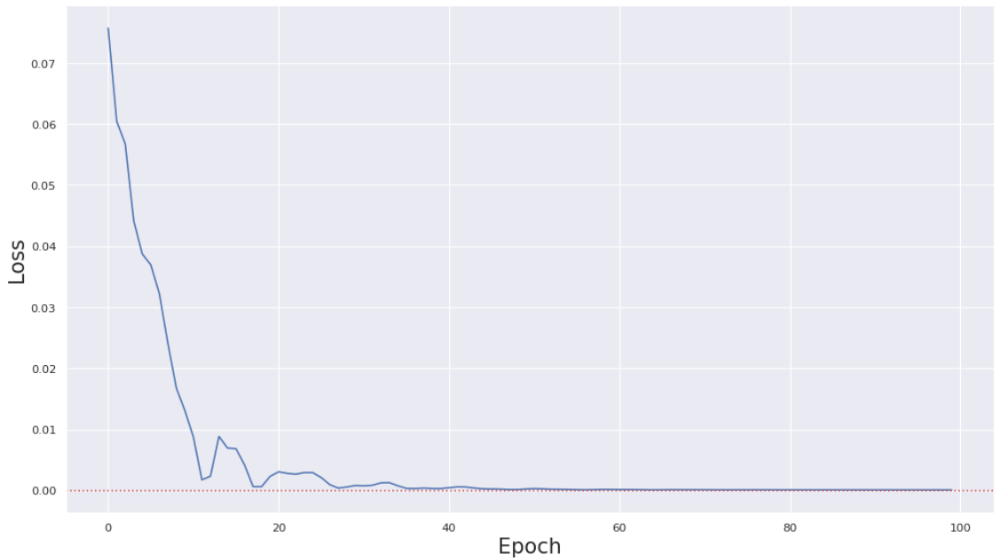
3) GRU-The Gated Recurrent Unit
PROJECT

Slide 40
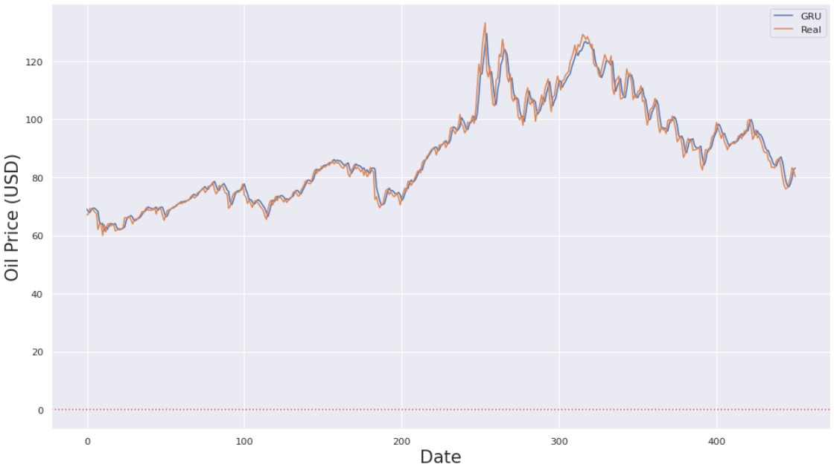
PROJECT

Slide 41
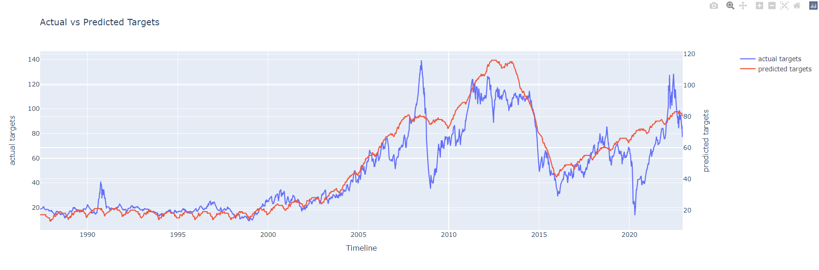
3) Actual Vs Predicted Targets
PROJECT

Slide 42
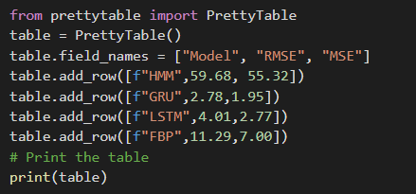
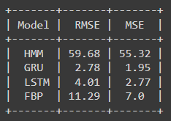
Conclusion
PROJECT

Slide 43
PROJECT
Deployment

Slide 44

Deployment is done using Streamlit and connecting it with binary.
PROJECT

Slide 45
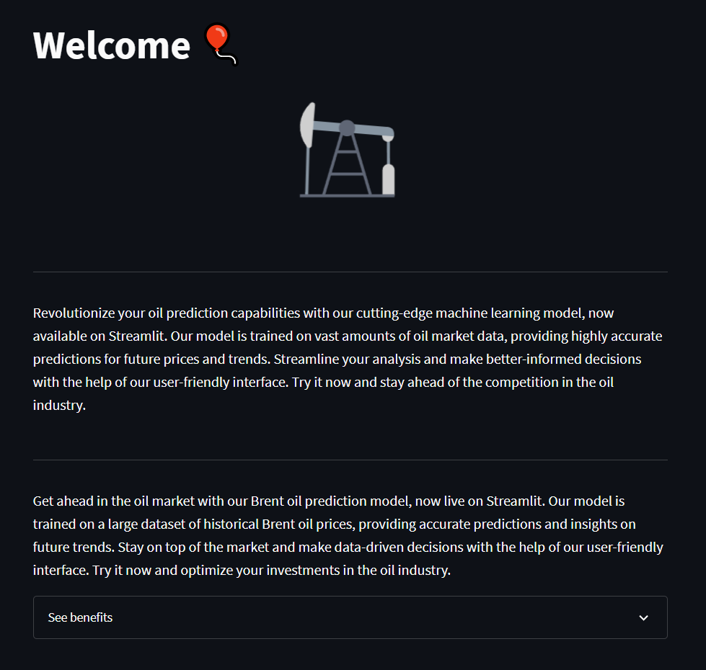
Main Page
PROJECT

Slide 46
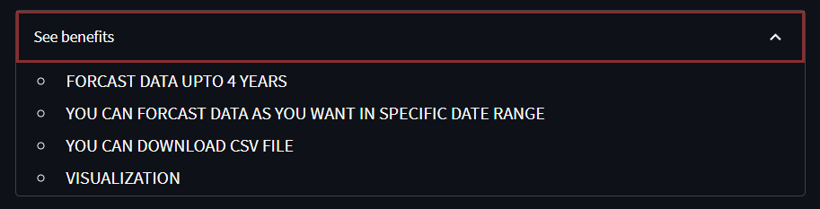
Benefits
PROJECT

Slide 47
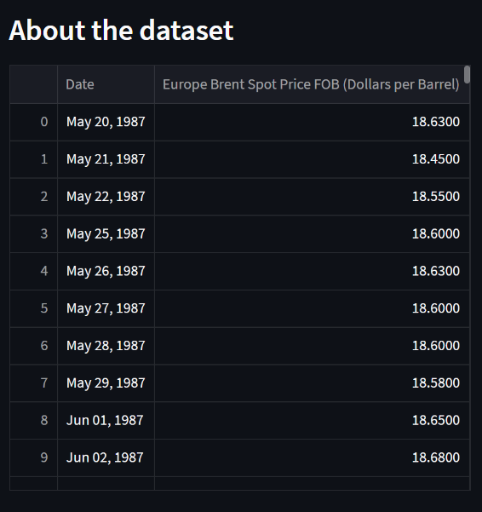
Forcasting
PROJECT

Slide 48
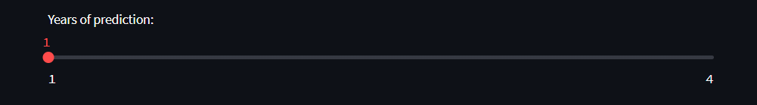
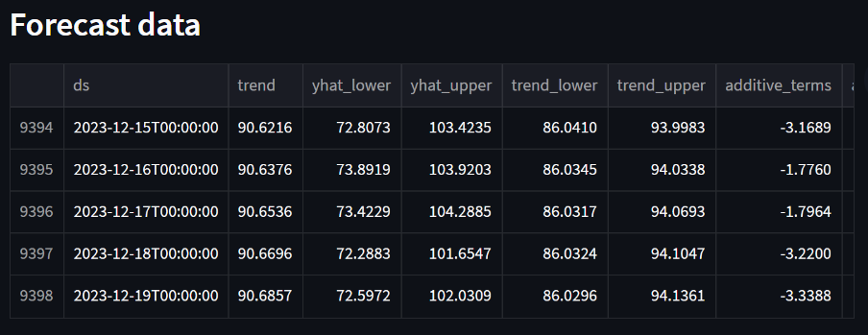

PROJECT

Slide 49

Forcasted data visualization
PROJECT

Slide 50


Forcasted Component
PROJECT

Slide 51

Forcasted Component
PROJECT

Slide 52


Forcasted Prices as you want
PROJECT
Download CSV file

Slide 53

Visualization
PROJECT

Slide 54

Histogram
PROJECT

Slide 55

Line Chart
PROJECT

Slide 56
Challenges Faced
1)Model selection: There are many different types of models that can be used to forecast time series data, and selecting the right one for a specific dataset can be challenging.
PROJECT
2)Large historical data: Oil prices have only been actively tracked for a relatively large period of time, which can make it difficult to accurately forecast future prices.

Slide 57
Team Member’s
PROJECT
Mr. Om Gorantiwar.
Mr. Kunal Shinde.
Ms. Shivani Dogne.
Ms. Suraksha Patel.
Ms. Bhumika Patil.

Slide 58
PROJECT
Thank You

